Slide 1
@googleslides
Frankenstein
Mary Shelly

Slide 2
ABOUT
Me
Hartsville, SC
English Major at USC; Minor in Public Relations and African American Studies
I am a Marvel Comic and Disney fanatic

Slide 3
Write down three questions that you have so far about the novel

Slide 4
SSR

Slide 5
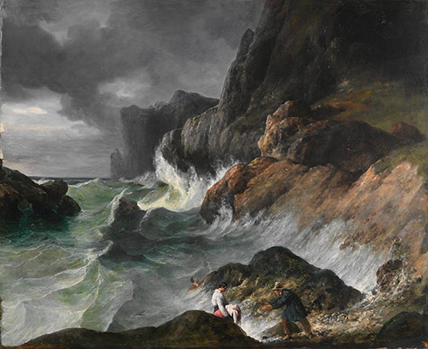
Emphasis on emotion
Glorification of nature
Romanticism

Slide 6
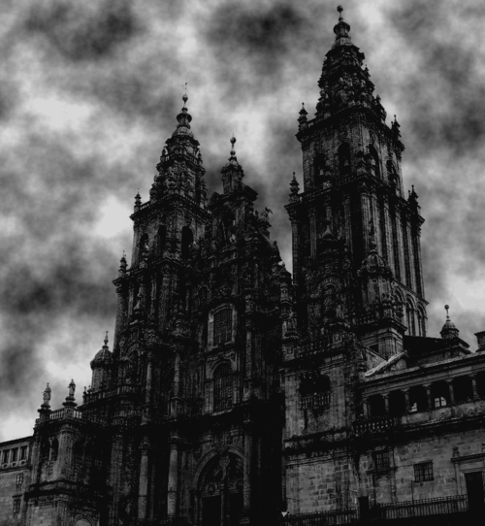
Gloomy
Dark, Foreboding
decaying setting
Gothic

Slide 7
Gothic
Romanticism
Gloomy, decaying setting (haunted houses or castles with secret passages, trap doors, and other mysterious architecture)
Supernatural beings or monsters (ghosts, vampires, zombies, giants)
Curses or prophecies
Damsels in distress
The emphasis on gloom and horror
Intense emotions
Emphasis on emotion
Glorification of nature
Free expression of feelings/individualism
Feeling over reason; individual thought over restraints

Slide 8
Gothic Literature
The Norton Anthology of English Literature (3)
English Romanticism
English literature - The Romantic period | Britannica.com (3)

Slide 9
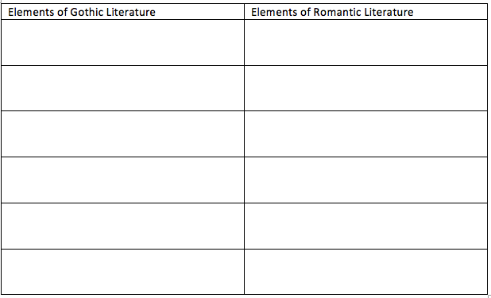
Gothic/Romanticism in Frankenstein
What are the characteristics of the Gothic novel do you see so far in the chapters? Complete the chart below by writing a quote that displays those elements. Do not forget to include the page number
The author shows deep emotions through the emotional internal dialogue about his surroundings; there is also a snippet of gloom in how the wood is described
Deep emotional conflict; glorification of nature through the descriptions of his surroundings
“The sounding cataract haunted him like a passion: the tall rock, the mountain, and the deep gloomy wood..An appetite; a feeling, and a love…”(Ch. 18; pg115)
“The sounding cataract haunted him like a passion...An appetite; a feeling, and a love…”(Ch. 18; pg115)

Slide 10
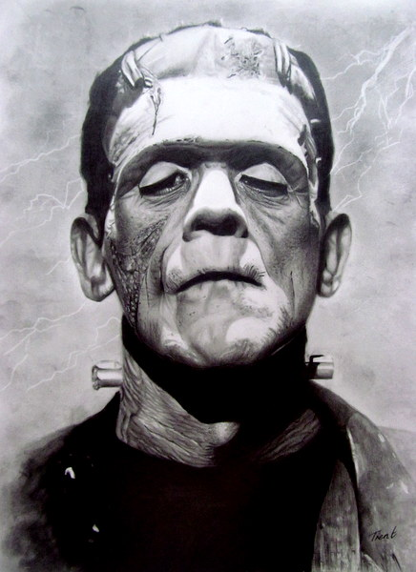
Discussion Questions
What makes the creature a monster rather than a human being?
Victor never gives his monster a name. What does this do for the story and even for the monster? Why do you think people think that the monster’s name is Frankenstein?
Discuss the novel’s shifts in narrative perspective. How does the different characters’ viewpoints, especially those of Victor and the monster effect the narrative?

Slide 11
Upcoming Socratic Seminar
Take the time to find at least one source that can be used for the Socratic Seminar that ties back to the essential question
“What is the purpose and/or value of life?”
Examples: Where their people in history who didn’t human value life? Should we only value human lives, what about animals? How do different cultures describe how life begins and ends?

Slide 12
Exit Slips
QUESTIONS?
Answer the first question and chose which of the other questions you would like to answer as an exit slip
Write down at least two elements of both English Gothic and Romantic literature (without looking at your notes)
and
What questions do you still have regarding either the Frankenstein and/or Gothic/Romantic literature?
Do you like Romanticism, Gothic, or both? Explain your answer in complete sentences.
Do you consider Frankenstein more of a Gothic or Romantic novel? Explain why in complete sentences.

Slide 13
@googleslides
THANK
YOU
Notes:
http://www.1001freedownloads.com/free-vectors/
https://www.pexels.com/photo/city-people-street-sun-2288/
https://www.pexels.com/photo/working-typing-macbook-computer-7350/
http://freegoogleslidestemplates.com
https://images.unsplash.com/photo-1414788020357-3690cfdab669

